Slide 1
Experimental Thermodynamics (30 common techniques)
Thermal analysis
Calorimetry
Differential Scanning Calorimetry
Modulated DSC
Microcalorimetry
Differential Thermal Analysis
Bomb Calorimetry/Combustion Calorimetry
Thermal Gravimetric Analysis/DTA/MS/IR/Raman
Colligative Analysis
Membrane Osmometry
Vapor Pressure Osmometry
Melting point/Boiling point
Density
Archimedes Method
Helium Pycnometry
Density Gradient Column
Dilatometry
Sound Velocity
Shock Compression
Abbe Refractometer
Ellipsometer
Surfaces
Gas Adsorption
Contact Angle
Zeta Potential
X-ray and Neutron Reflectivity
Phase Structure
Light, X-ray, Neutron Scattering
Osmotic Compressibility
OM, SEM, TEM, AFM
XRD, NPD
Chemical Methods

Slide 2
Calorimetry
Thermal analysis
Calorimetry
Differential Scanning Calorimetry
Modulated DSC
Microcalorimetry
Differential Thermal Analysis
Thermal Gravimetric Analysis
Bomb Calorimetry/Combustion Calorimetry

Slide 3
dT/dQ is measured in the DTA
dQ/dT is measured in the DSC
Calorimetry
How to build a scanning calorimeter
What is needed?
One or Two Adiabatic/Isolated Cells
Thermocouples, T
Heating rate, dQ/dt
Mass, m
Simplest approach and useful for very low or very high temperatures is differential thermal analysis DTA
DTA is a simple design for difficult environments
Two cells heated at same rate and the difference in temperature is recorded
Differences in heat capacity and latent heats create differences in temperatures through transitions.

Slide 4
Measure the Temperature
Seebeck Effect: Thermocouple
Electrons (or holes) flow from the hot side where they have high kinetic energy to the cold side where they have less kinetic energy. They will spend more time in the cold side, something like condensing in the cold side. This effect is different in magnitude for different metals or semiconductors. The difference in potential at the cold side between two metals is proportional to the temperature. (Similar to thermophoretic sampling.)
Thermally insulating
Electrically conducting
Thermocouple
Thermoelectric generator

Slide 5
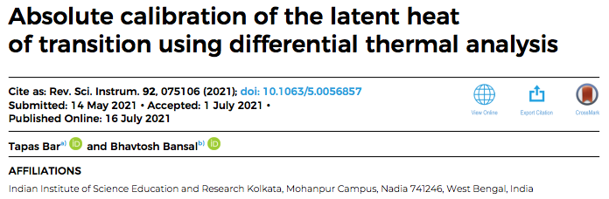
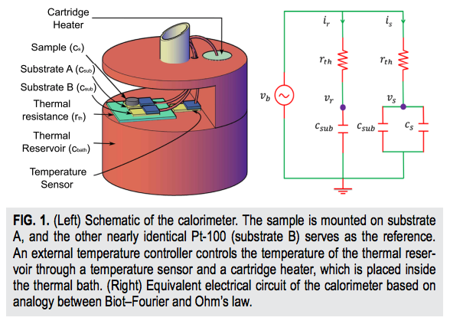

Slide 6
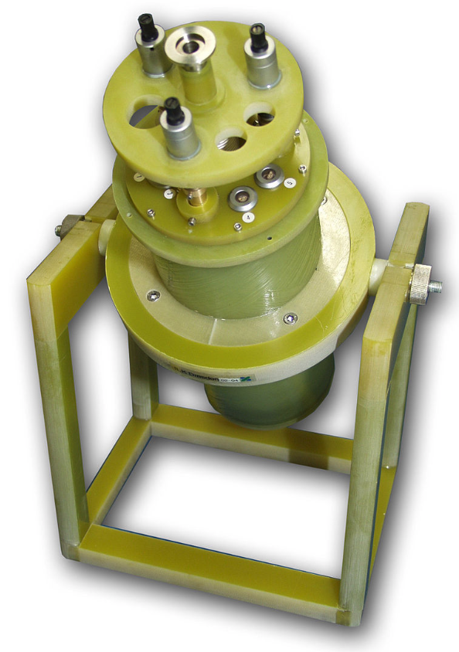
Calorimetry
Cryostat
Use liquid He or a He refrigerator
4.2K boiling point

Slide 7
Calorimetry
dQ/dt = C_{p} dT/dt + ΔH_{transitions}
ΔQ = C_{p} (T_{f}-T_{i})+ ΔH_{transitions}
T_{f} = T_{i} + (ΔQ – ΔH_{transitions})/C_{p}
ΔQ = (dQ/dt) t
dT/dQ is measured in the DTA
dQ/dt = (dT/dt)/(dT/dQ)
dQ/dT is measured in the DSC
dQ/dt = (dQ/dT) (dT/dt)

Slide 8
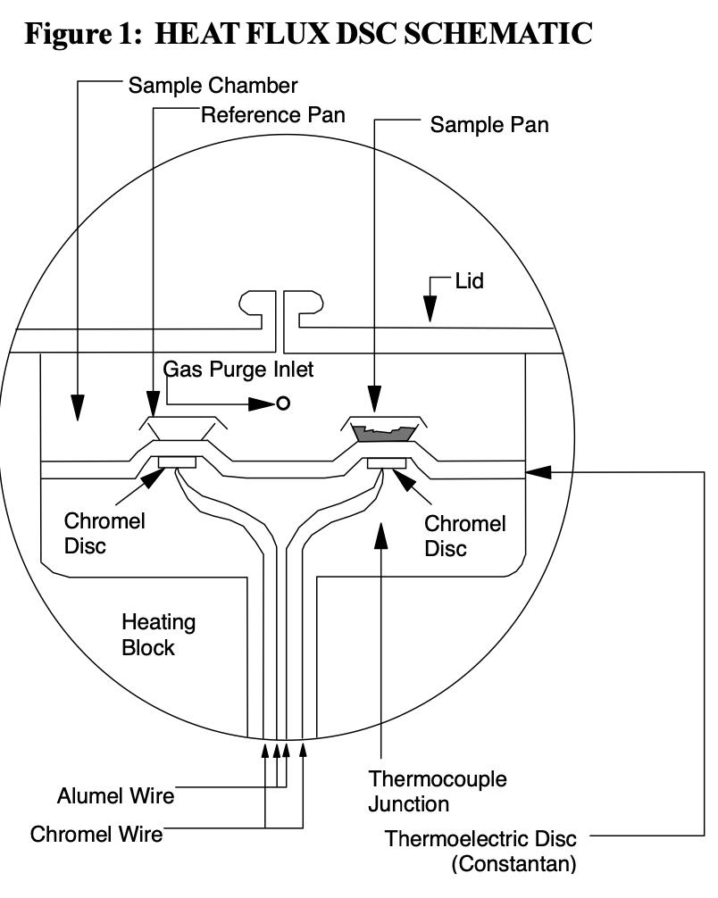
Modulated DSC

Slide 9

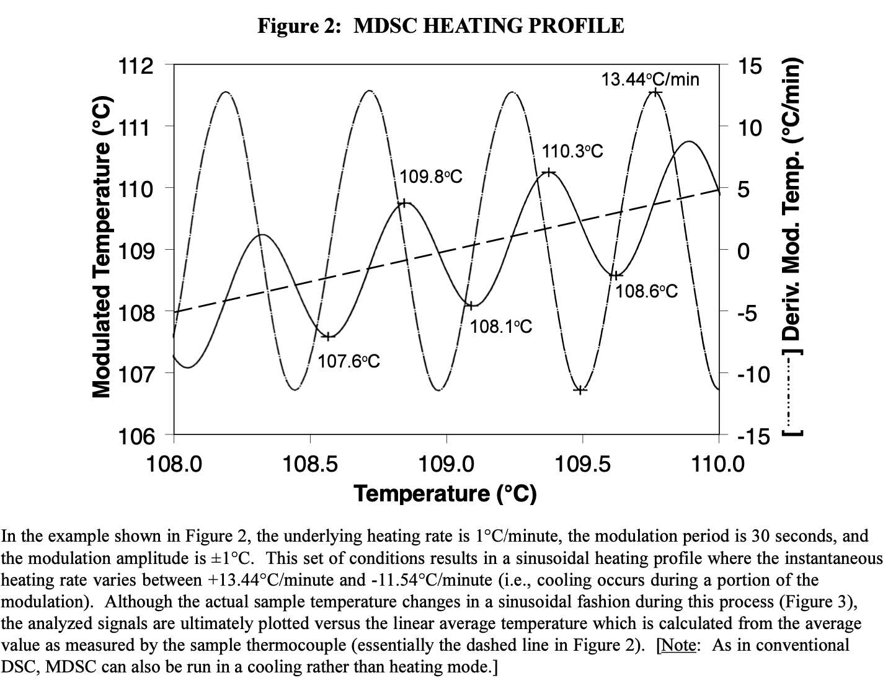

Slide 10
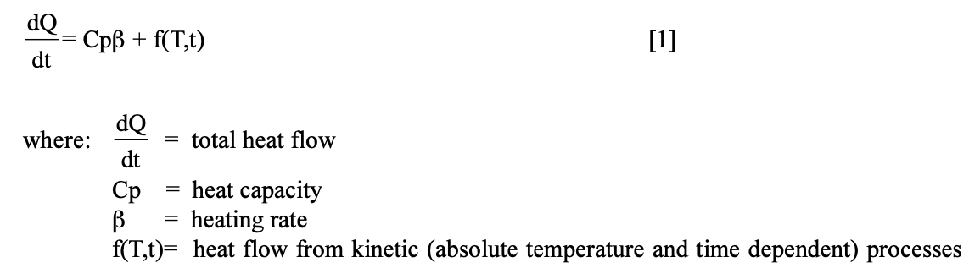

Slide 11
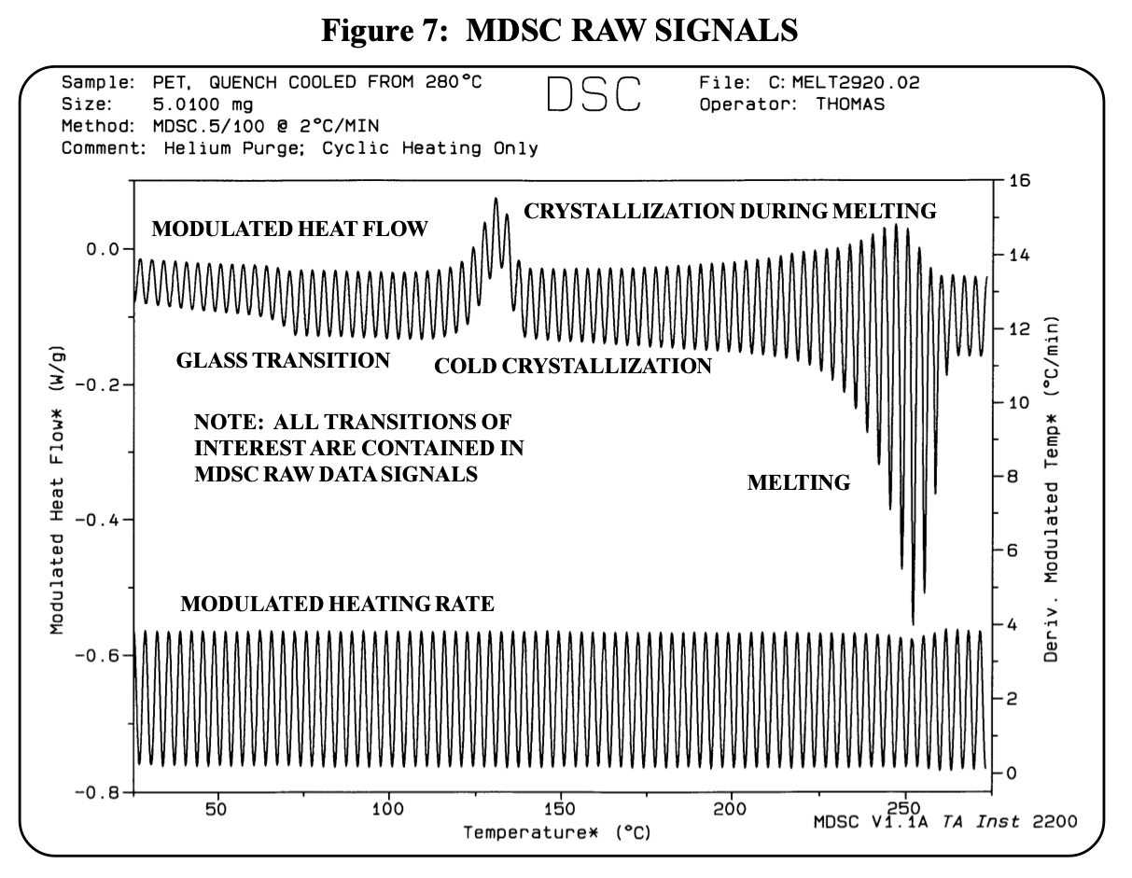

Slide 12
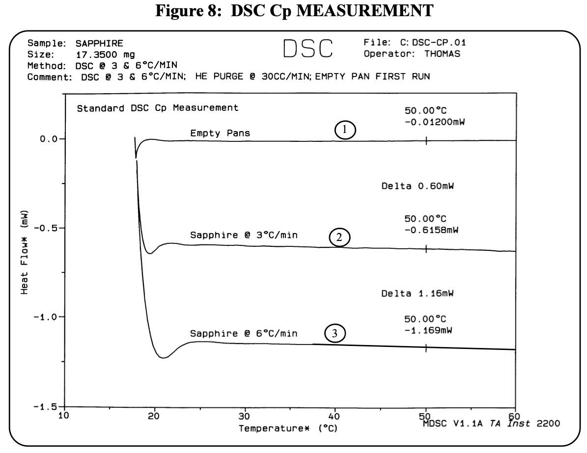

Slide 13
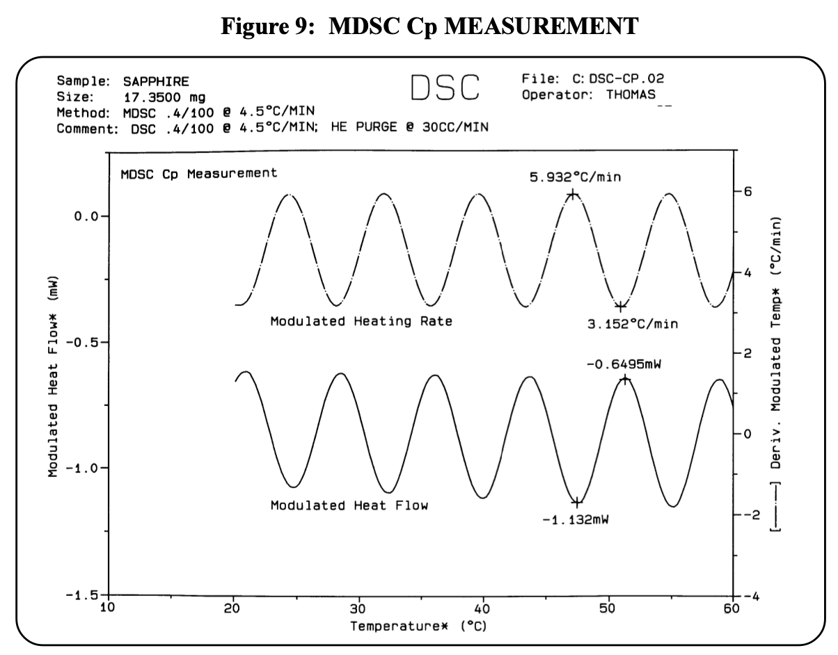

Slide 14
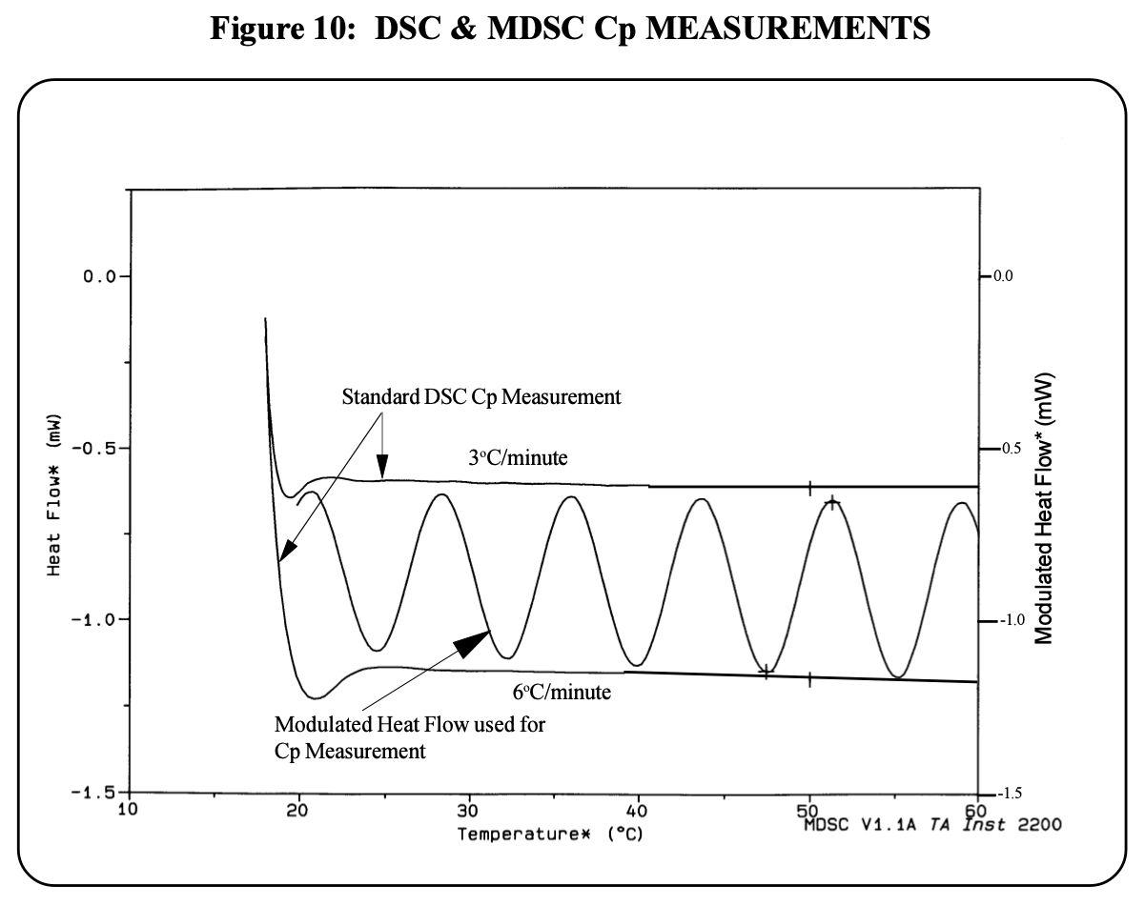

Slide 15
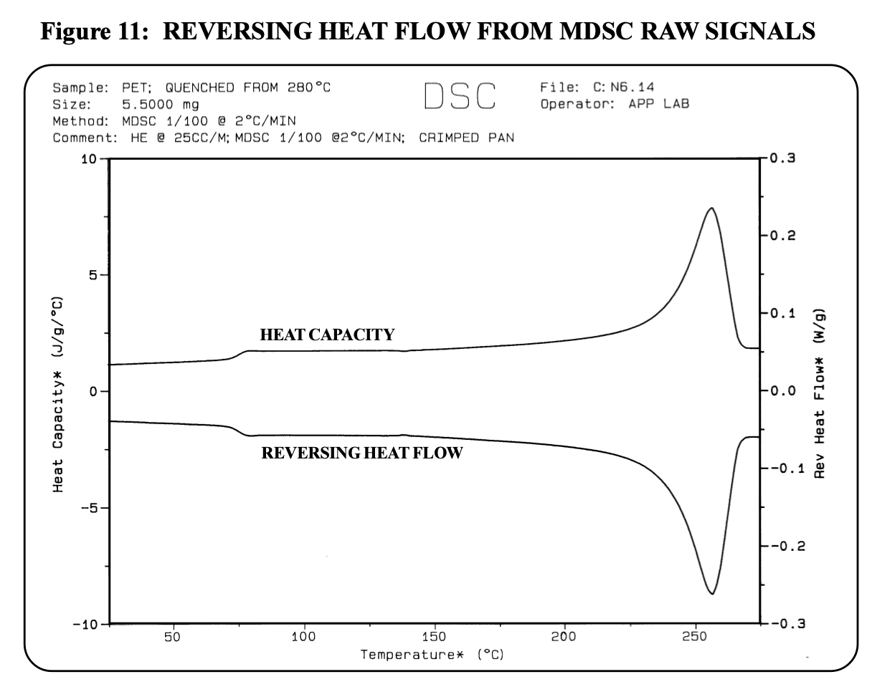

Slide 16
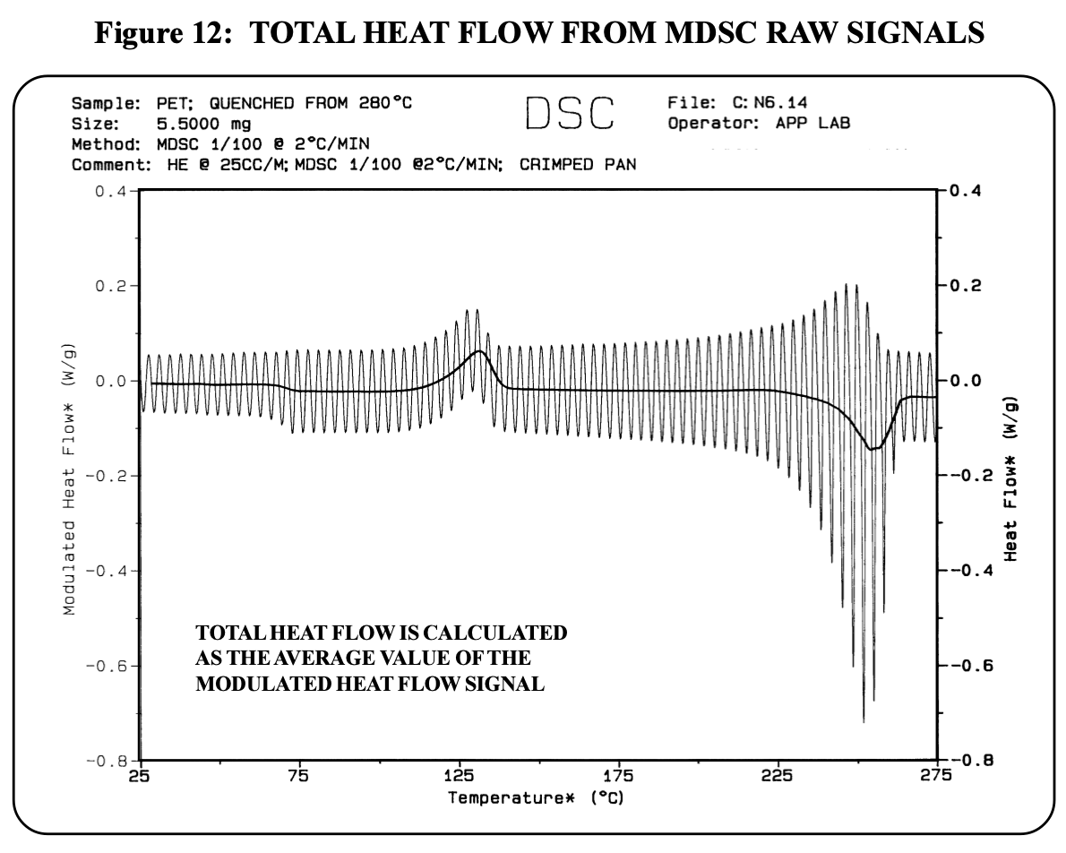

Slide 17
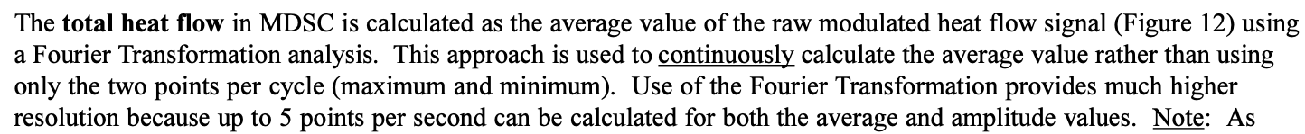

Slide 18
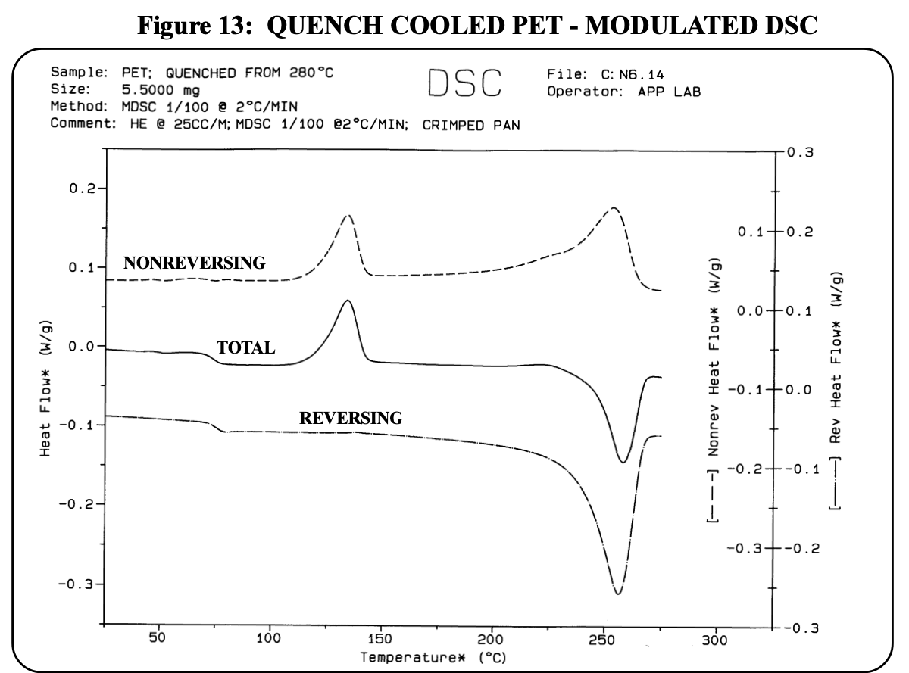

Slide 19
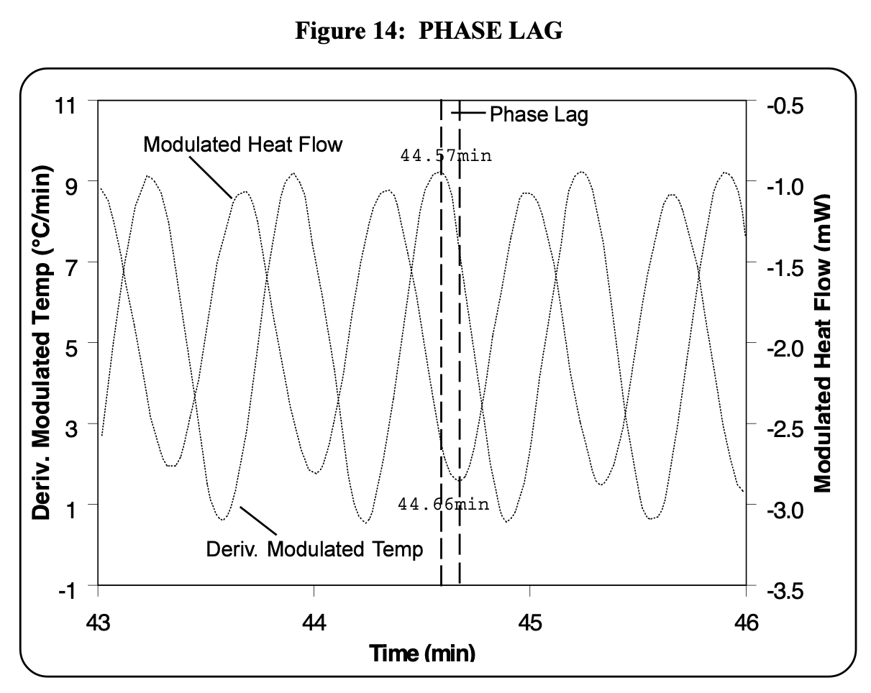

Slide 20
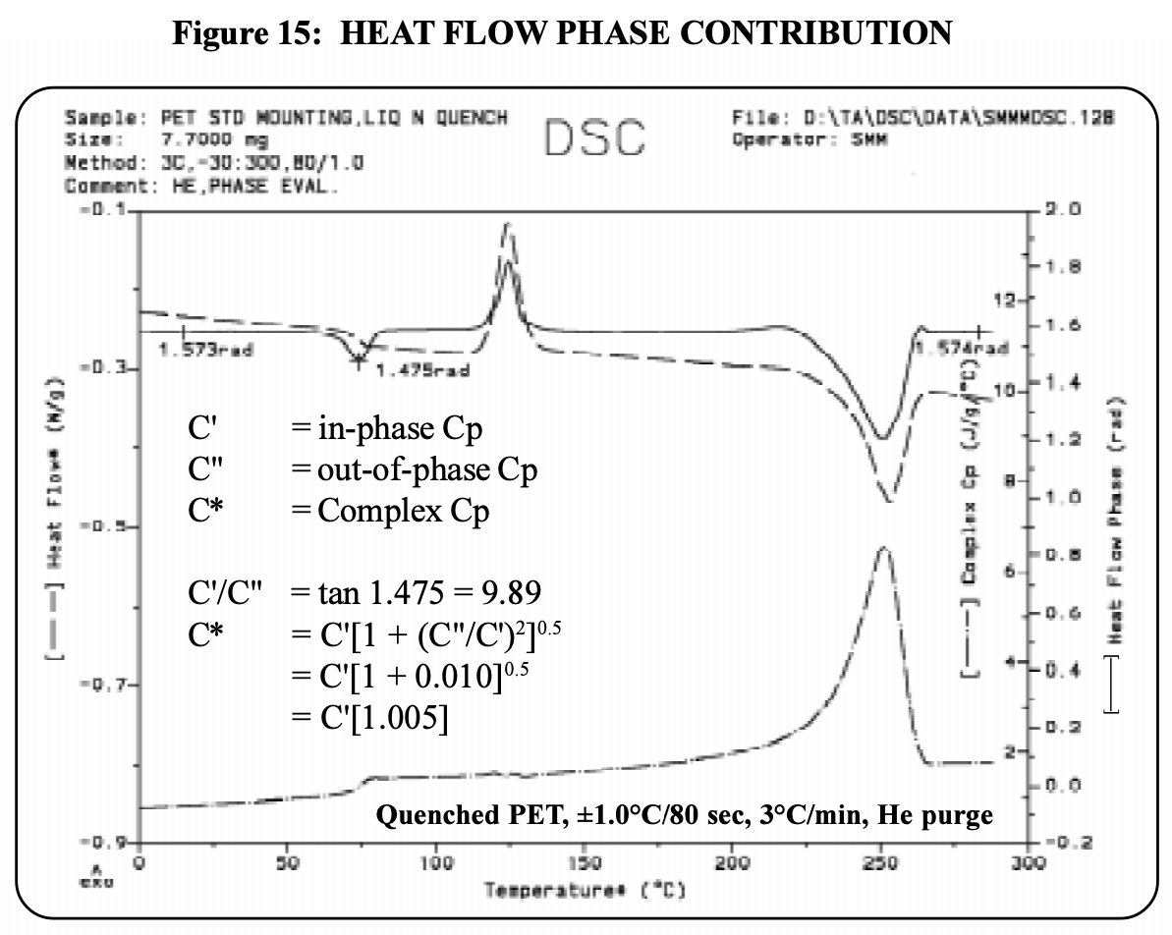

Slide 21
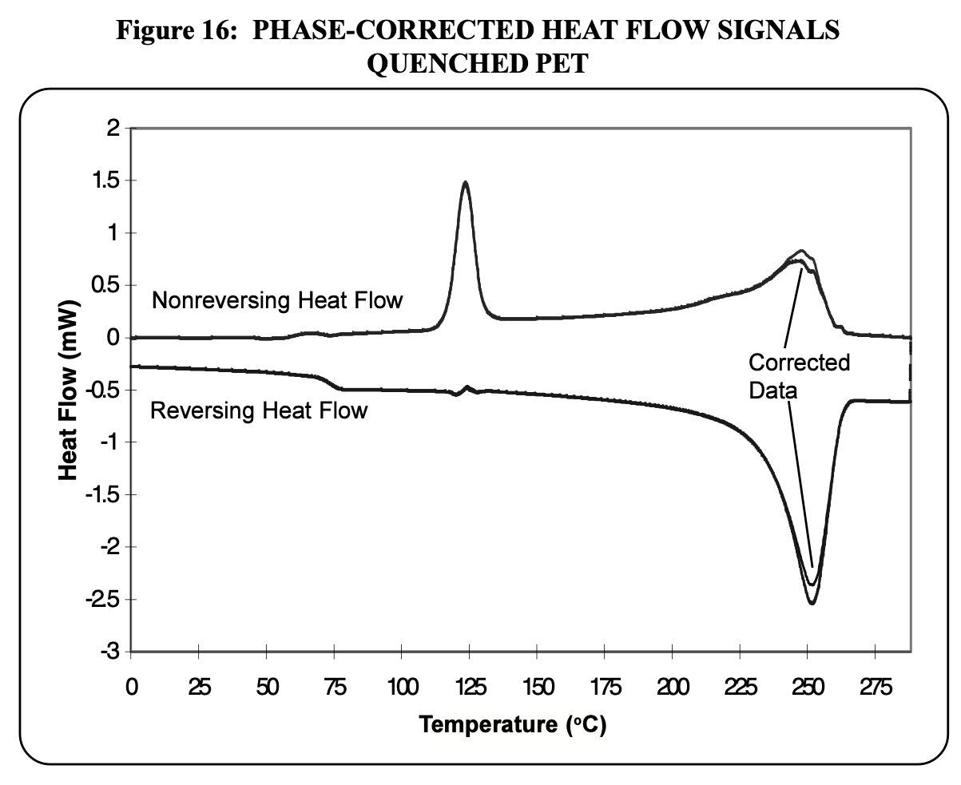

Slide 22
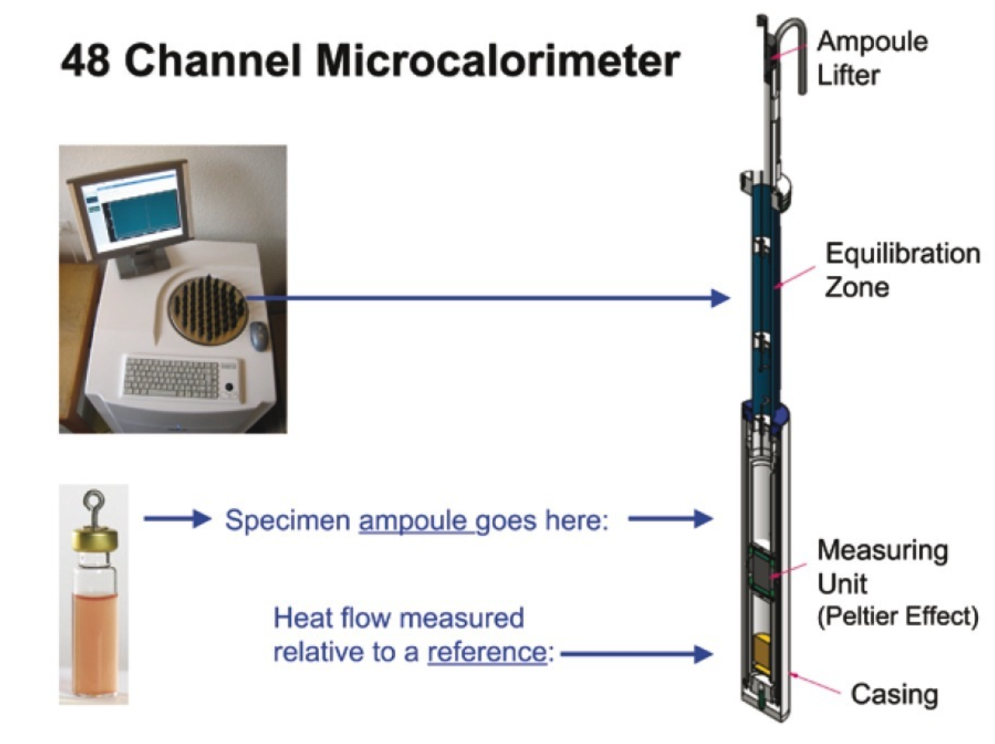
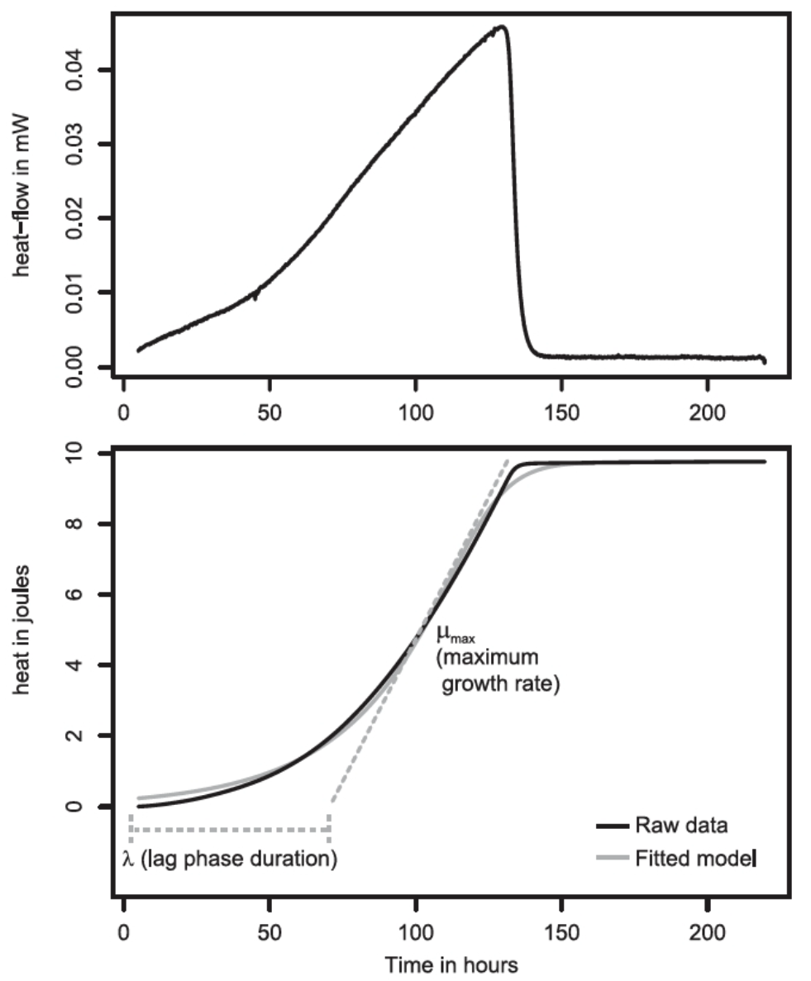
Micro Calorimetry (isothermal shown)

Slide 23
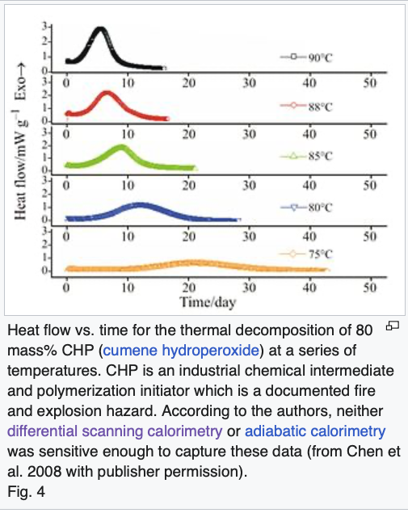
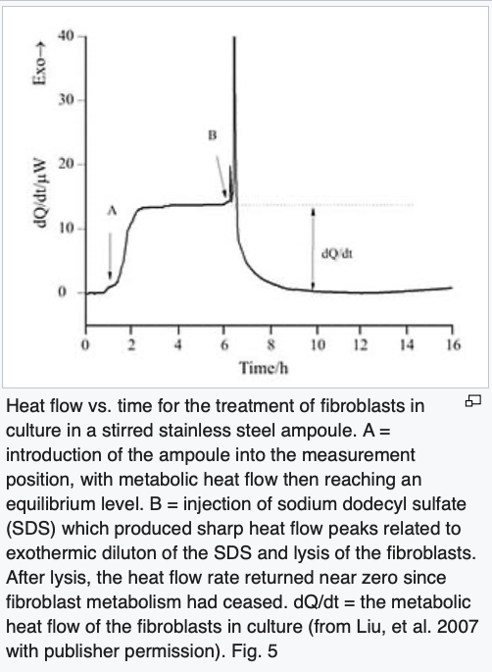

Slide 24
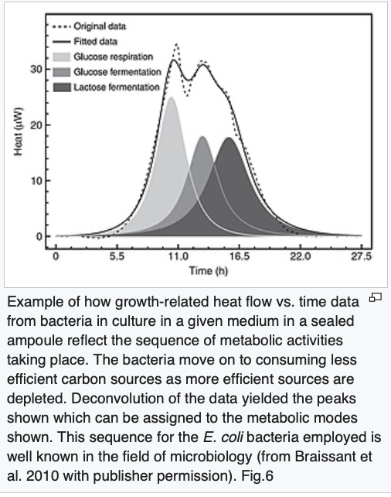
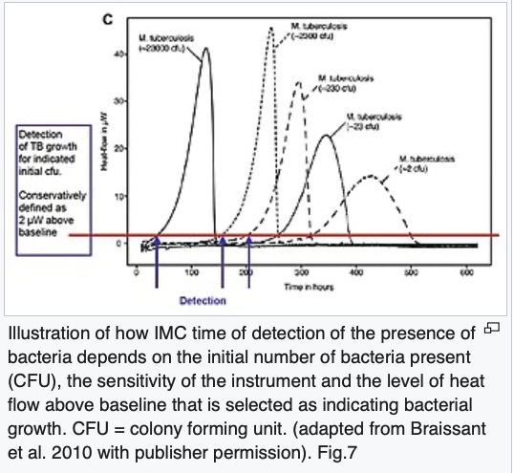

Slide 25
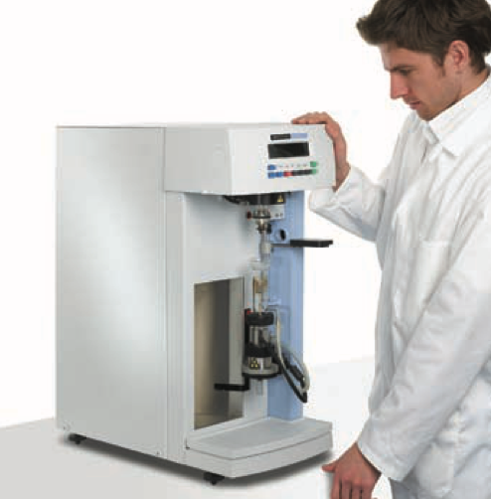
Thermogravimetric Analysis (TGA)

Slide 26
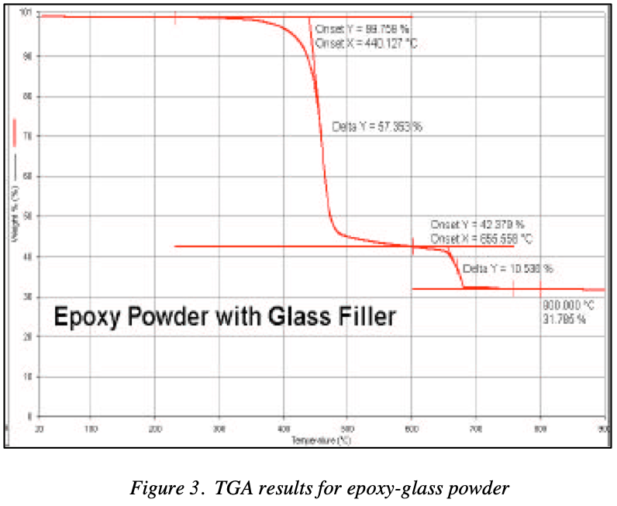
Thermogravimetric Analysis (TGA)

Slide 27
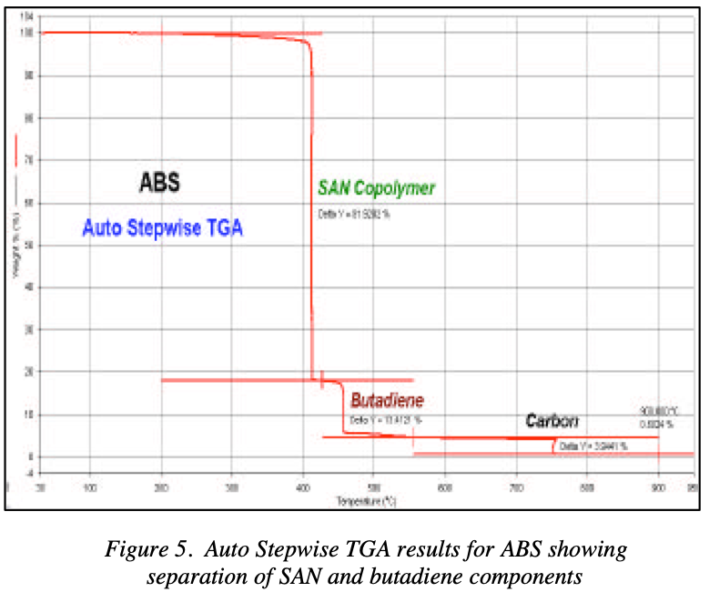

Slide 28
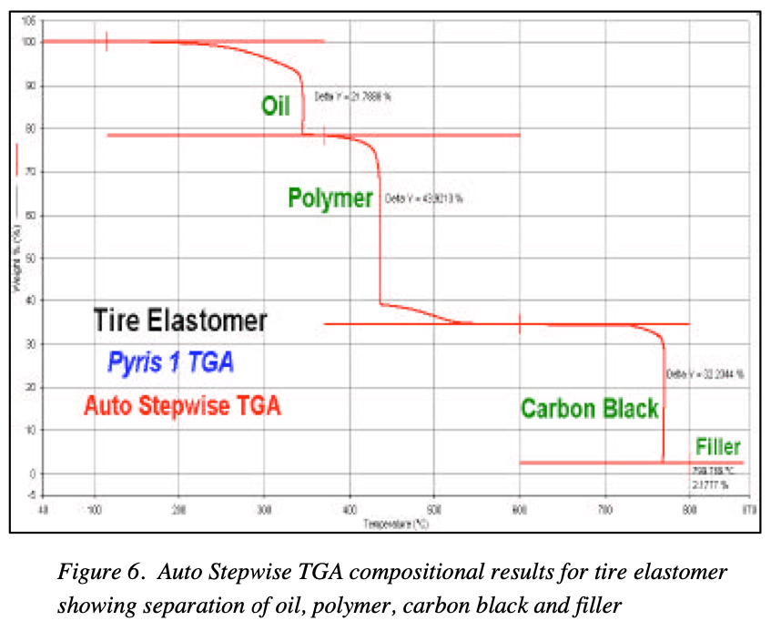

Slide 29
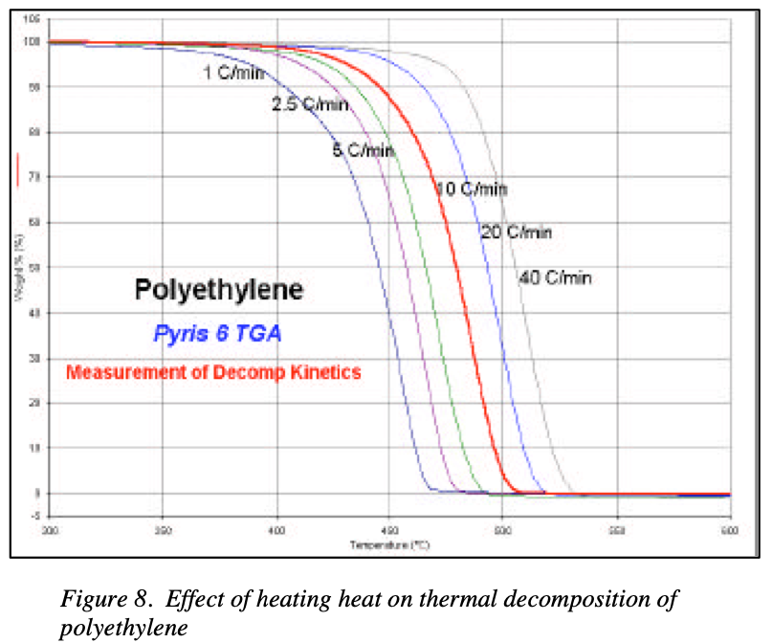

Slide 30
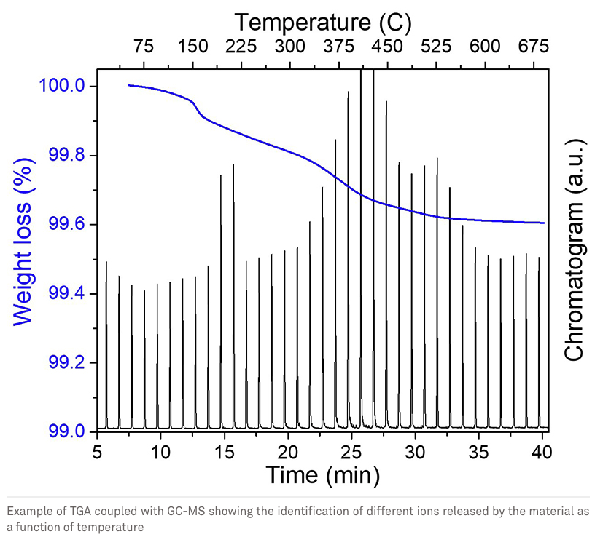
TGA/MS
GC
IR
Raman
Etc.

Slide 31
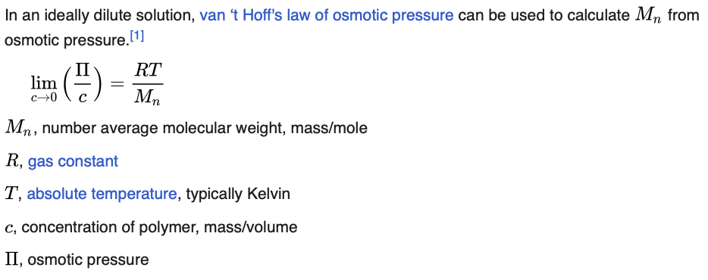


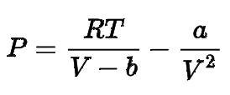
Membrane Osmometry
Π = ρgh
Van der Waals Equation P = Π
Van der Waals
b = Excluded volume
a = attractive potential

Slide 32

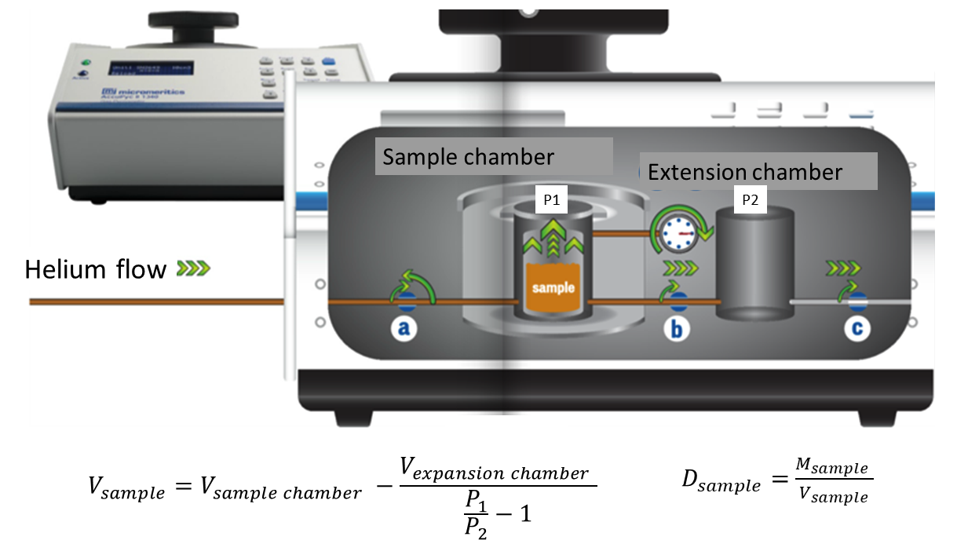
Archimedes Method for Density
Helium Pycnometry
Helium density
Boyle’s Law (P₁V₁ = P₂V₂)
Measure pressure change to get volume
Weigh sample
“Open pore” density

Slide 33
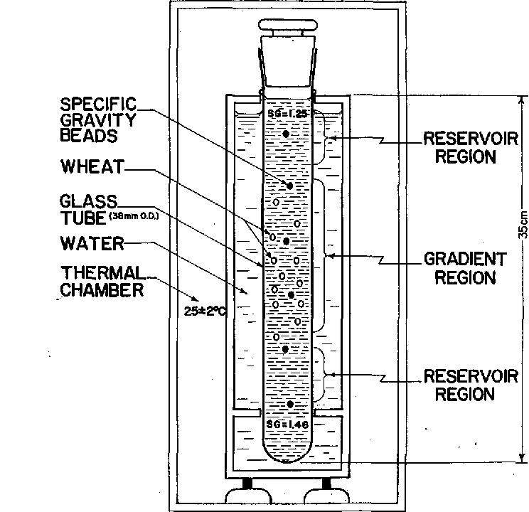
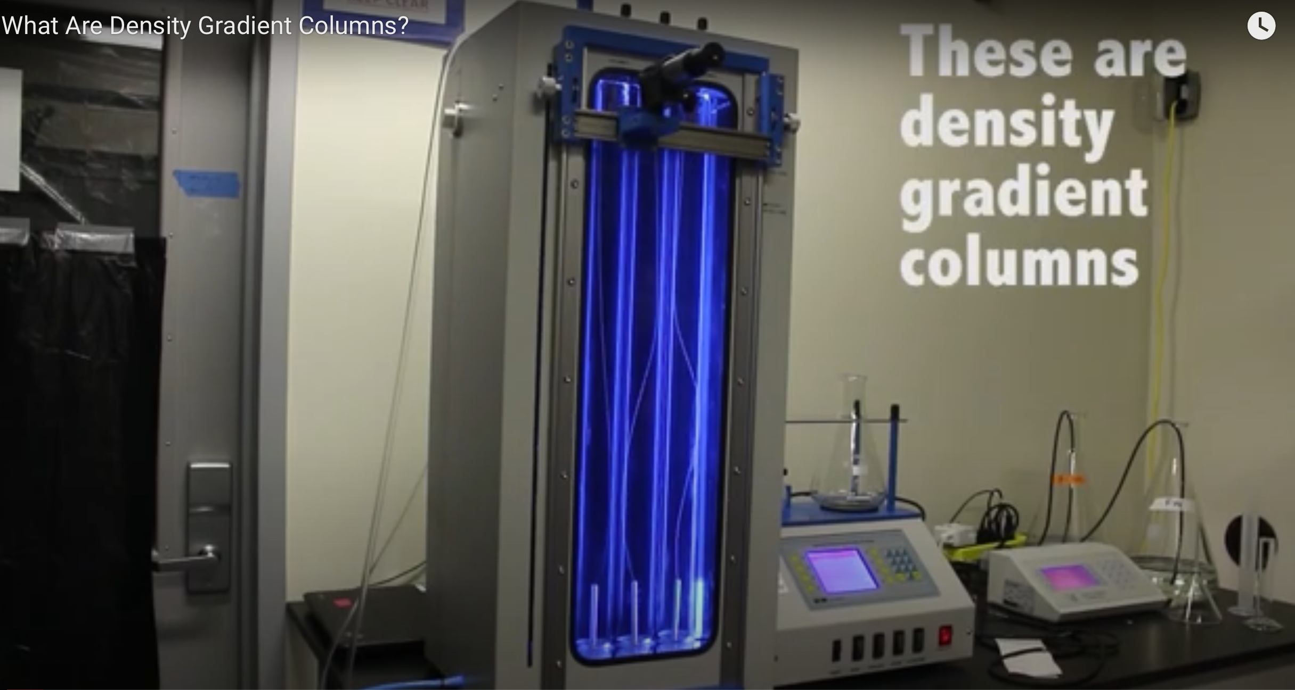
Density Gradient Column

Slide 34
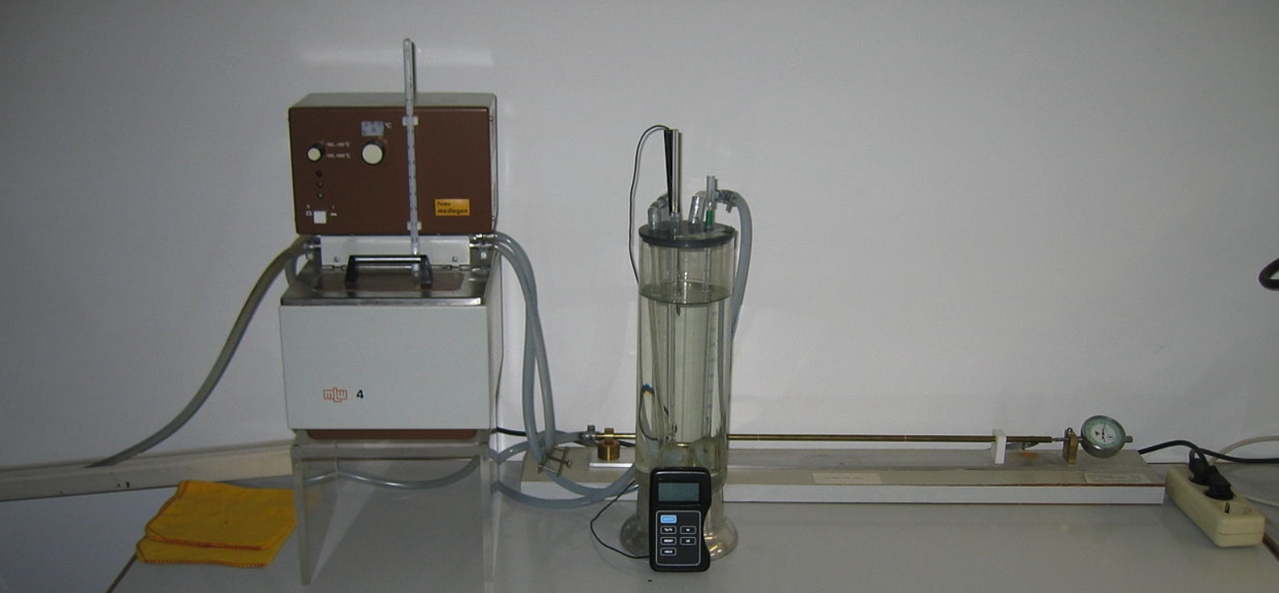
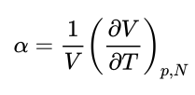
Mercury Dilatometry for Thermal Expansion Coefficient, α

Slide 35
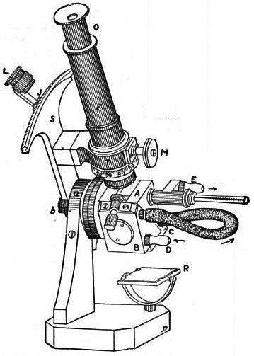
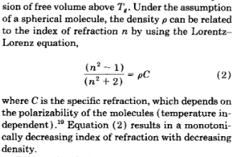

Abbe Refractometer

Slide 36
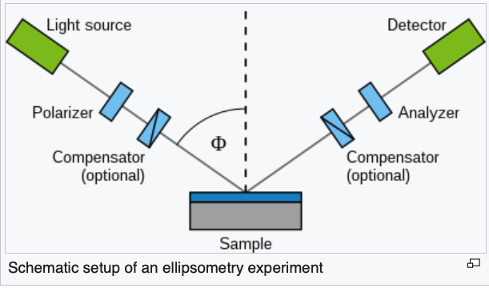
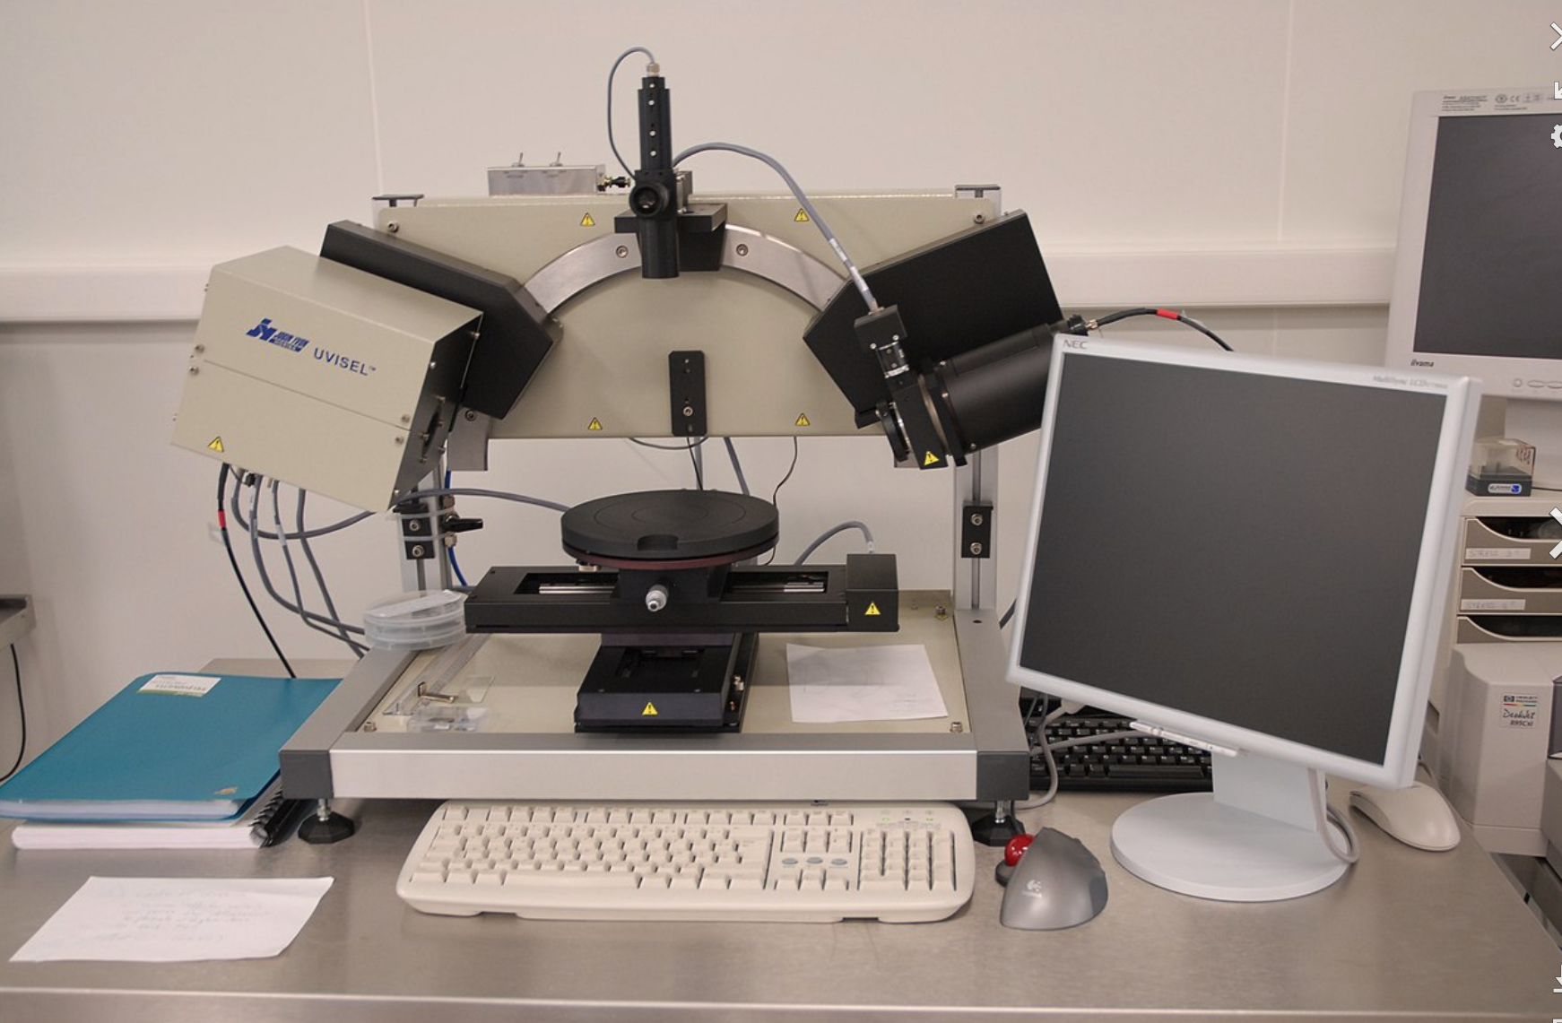
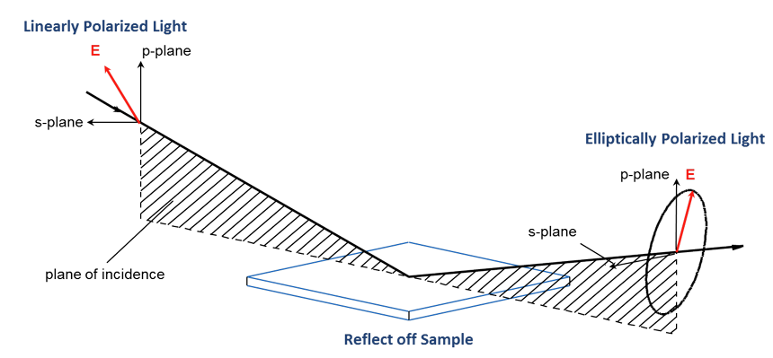
Index (and thickness) of thin films Ellipsometer

Slide 37
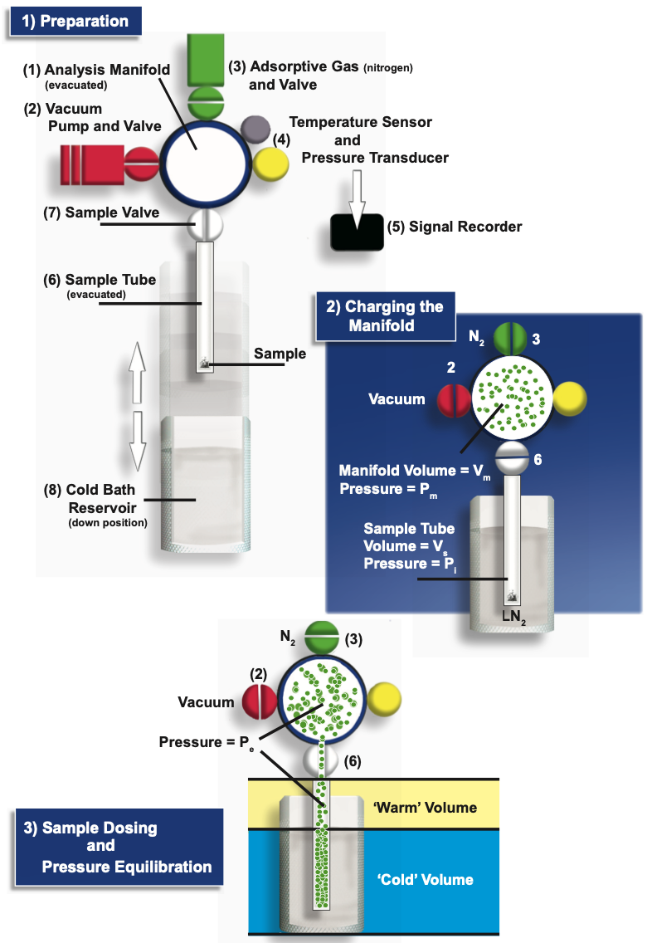
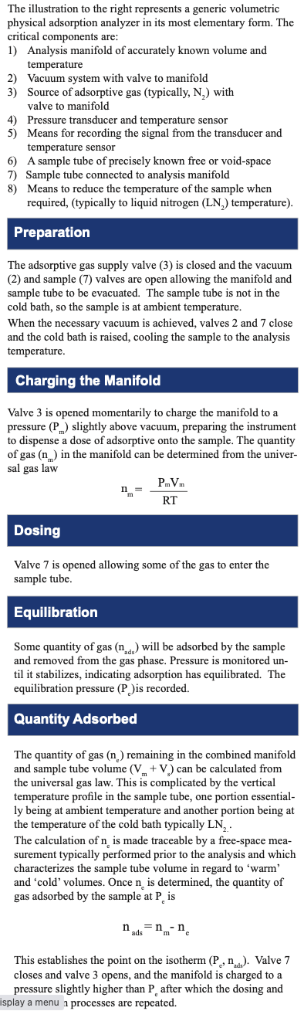
Surfaces:
Gas Adsorption

Slide 38
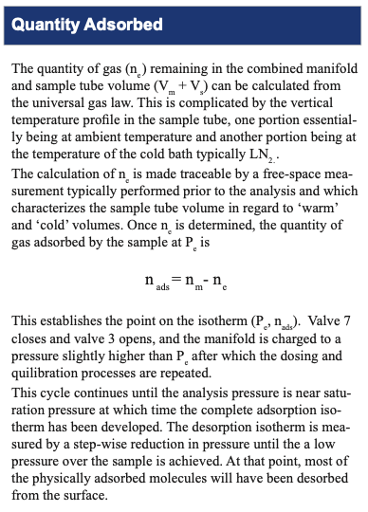
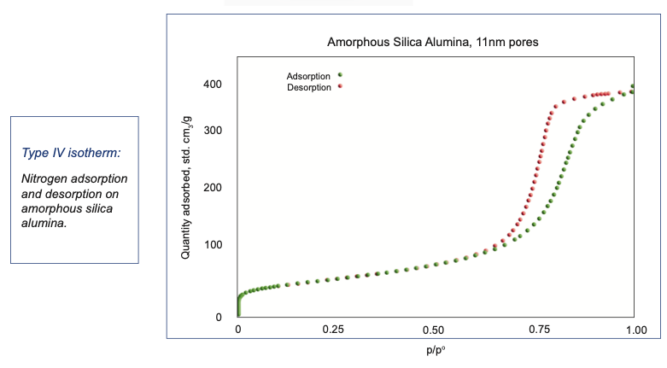
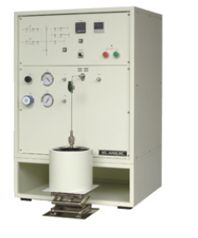

Slide 39
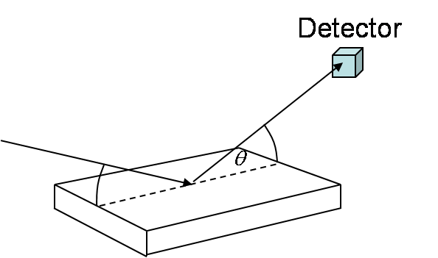
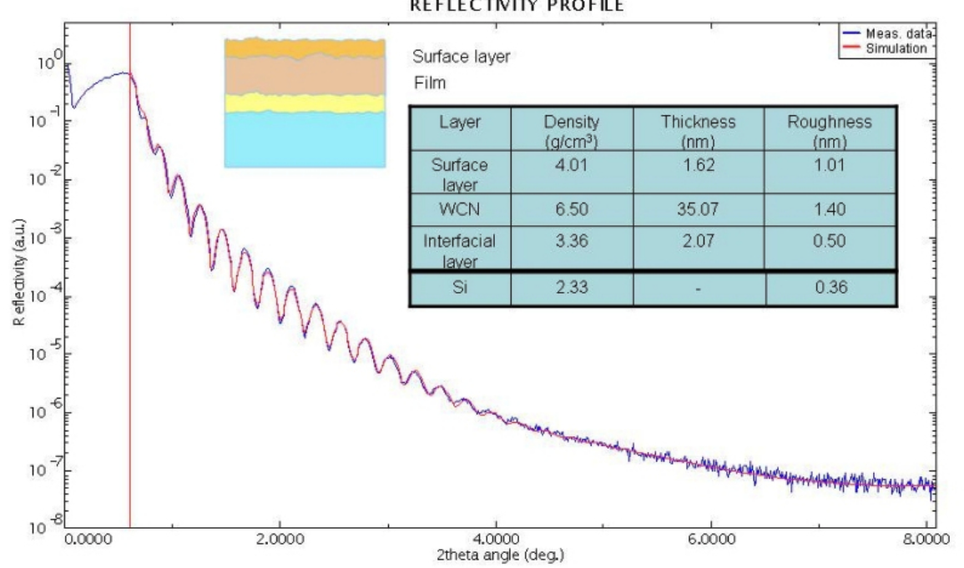
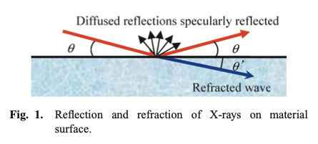
X-ray and Neutron Reflectivity

Slide 40
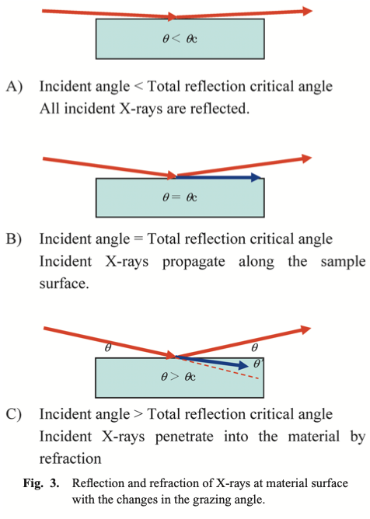



Slide 41



Slide 42


Slide 43


Slide 44


Slide 45


Slide 46



Slide 47

Small-Angle Light, Neutron, and X-ray Scattering for Osmotic Compressibility
“Thermodynamic Limit”
At large sizes contrast arises from thermally driven fluctuations in density that are opposed by the osmotic compressibility, (dρ/dP)_{T} The observed intensity I(q=>0) ~ kT/ (dρ/dP)_{T}
Here P is Π the osmotic pressure which can be expressed using the virial expansion so that the first derivative is the second virial coefficient A₂. Low-q scattering can measure the thermodynamic interaction of particles.
Large size
(2π/0.001) Å = 600 nm
Small size
(2π/1) Å = 0.6 nm

Slide 48

Low-q scattering allows measurement of the second virial coefficient B₂
Notes:
Kinetic distribution and dispersion of nanoparticles in polymer nanocomposites.
Fri. March 10, 11:54 a.m. – 12:06 p.m. PST
Room 128
Dispersion and distribution of nanoparticles in polymer mixing processes are stumbling blocks to the production of nanocomposites. Dispersion, in polymer processing, refers to the structural breakup of agglomerates of nanoparticles while distribution involves spatial randomization. These two features of mixing respond to different viscous flow regimes: laminar flow and turbulent flow. Distributive mixing is difficult in laminar flow, while dispersive structural change can result from either laminar or turbulent flow. In kinetic mixing, agglomerates of immiscible nanoparticles or aggregates on the nanoscale are dispersively broken apart in proportion to the accumulated strain. Parallel to this structural change, turbulent flow, related to the Reynolds number, convectively redistributes the nanoparticles or aggregates. This redistribution optimally leads to the formation of macroscopic filler networks completing a structural hierarchy necessary for ionic and electrical conductivity, tear strength, and modulus enhancement. Both distribution and dispersion depend on the velocity of flow, but they have inverse dependencies on the flow gap size in the simplest geometry. We have adapted the random phase approximation and the van der Waals model to understand kinetic dispersion and distribution in polymer nanocomposites.

Slide 49
Experimental Thermodynamics (30 common techniques)

Slide 50
Experimental Thermodynamics (30 common techniques)

Slide 51
Experimental Thermodynamics (30 common techniques)

Slide 52
Experimental Thermodynamics (30 common techniques)

Slide 53
Experimental Thermodynamics (30 common techniques)

Slide 54
Experimental Thermodynamics (30 common techniques)

Slide 55
Experimental Thermodynamics (30 common techniques)

Slide 56
Experimental Thermodynamics (30 common techniques)

Slide 57
Experimental Thermodynamics (30 common techniques)

Slide 58
Experimental Thermodynamics (30 common techniques)

Slide 59
Experimental Thermodynamics (30 common techniques)

Slide 60
Experimental Thermodynamics (30 common techniques)

Slide 61
Experimental Thermodynamics (30 common techniques)

Slide 62
Experimental Thermodynamics (30 common techniques)

Slide 63
Experimental Thermodynamics (30 common techniques)

Slide 64
Experimental Thermodynamics (30 common techniques)

Slide 65
Experimental Thermodynamics (30 common techniques)

Slide 66
Experimental Thermodynamics (30 common techniques)

Slide 67
Experimental Thermodynamics (30 common techniques)

Slide 68
Experimental Thermodynamics (30 common techniques)

Slide 69
Experimental Thermodynamics (30 common techniques)

Slide 70
Experimental Thermodynamics (30 common techniques)

Slide 71
Experimental Thermodynamics (30 common techniques)

Slide 72
Experimental Thermodynamics (30 common techniques)

Slide 73
Experimental Thermodynamics (30 common techniques)

Slide 74
Experimental Thermodynamics (30 common techniques)

Slide 75
Experimental Thermodynamics (30 common techniques)

Slide 76
Experimental Thermodynamics (30 common techniques)

Slide 77
Experimental Thermodynamics (30 common techniques)

Slide 78
Experimental Thermodynamics (30 common techniques)

